Slide 1

Guruji AIR - Centre of Excellence
(Innovation with Students)
Empowering schools to be technologically well-equipped

Slide 2

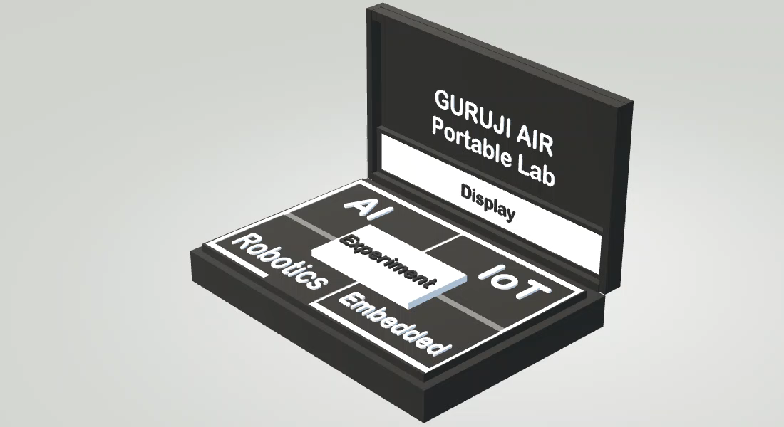
Solution: Presenting Guruji AIR Lab
Proprietary product design (Patent Applied)
Real life AI, IoT, Robotics
Experiments
Guruji AIR Lab develop,
Analysis and Monitoring of
Labs / Students
Weekly report for Teacher and Principal (Through Cloud)
Easy to Install and Use Affordable
Patent No- 202221006180
Co-created with teachers and students

Slide 3
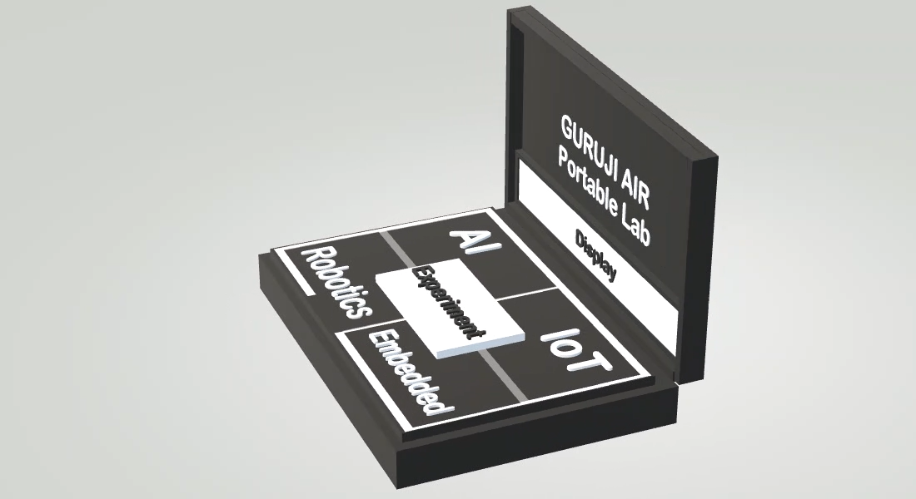
Revolutionary Product Architecture
GURUJI AIR
Cloud Platform
GURUJI
AIR
Department
School 1 Administration/
Principal
Analysis / Monitoring Report
Weekly Experiment Report
Experiment Data
Experiment Data
Result
Students
Display
Devices
Guruji AIR 1 App
Display
Devices
Guruji AIR 2 App
Students
All of the schools lab connected to Guruji AIR Cloud
AIR Lab 2 | SCHOOL 2
AIR Lab 1 | SCHOOL 1

Slide 4
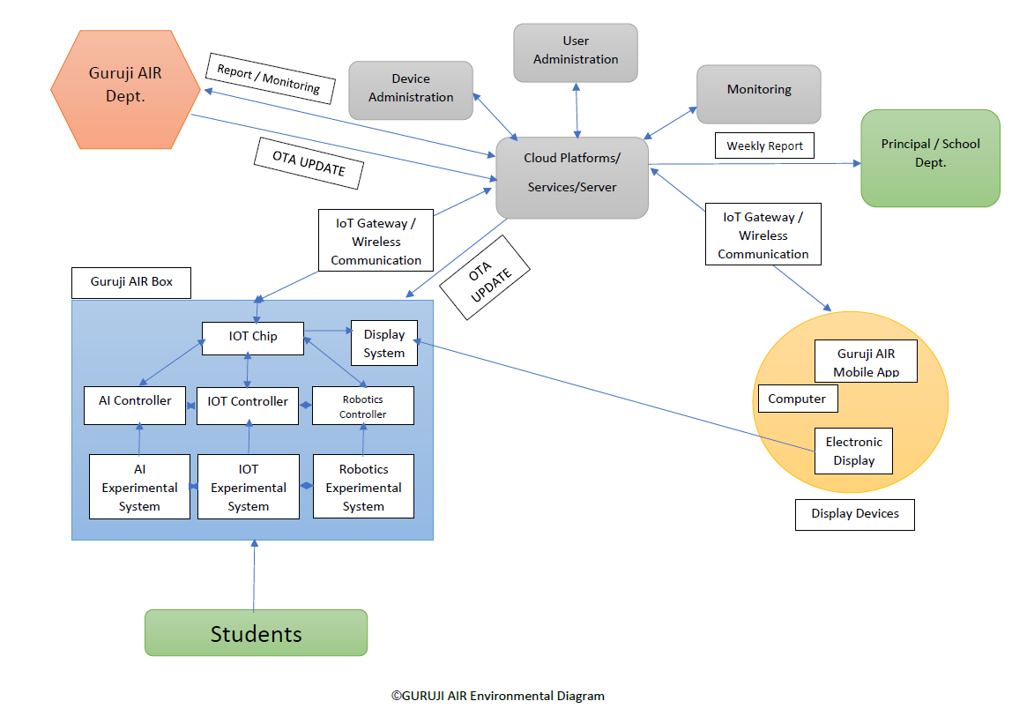
Revolutionary Product Architecture

Slide 5
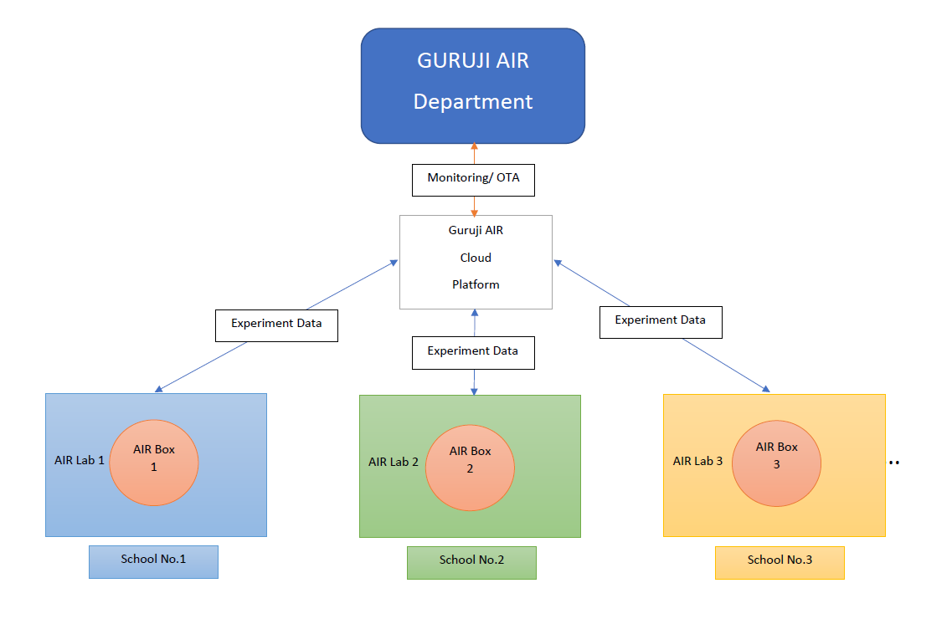
Schools-Guruji Architecture Guruji will have every school data for future aspect, Guruji can update programs and experiments on one click using OTA.

Slide 6

GURUJI AIR – Centre of Excellence is Open to Question and Your Valuable Feedback
Thank You

